Slide 1
Module 7

Slide 2

SURFACE AREAS
AND VOLUMES
CYLINDER - Introduction
Notes:
School
2

Slide 3
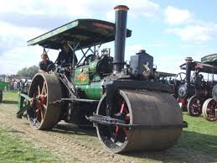
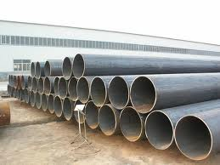
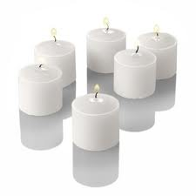
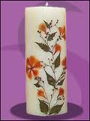
RIGHT CIRCULAR CYLINDER
Examples :
Let us see few examples
of right circular cylinder
Roller wheels
Pipes
Cylindrical candles

Slide 4
RIGHT CIRCULAR CYLINDER
The right circular cylinder has three faces.
r
1
Two circular faces
One curved face
Cylinder has radius ‘r’ and height ‘h’.
3
1
Let us see geometrical figure
of right circular cylinder
h
A cylinder has two circular
faces of same radii
Distance between the centers
of the circular faces is the
height of the cylinder
Height is the
perpendicular distance
2
r

Slide 5
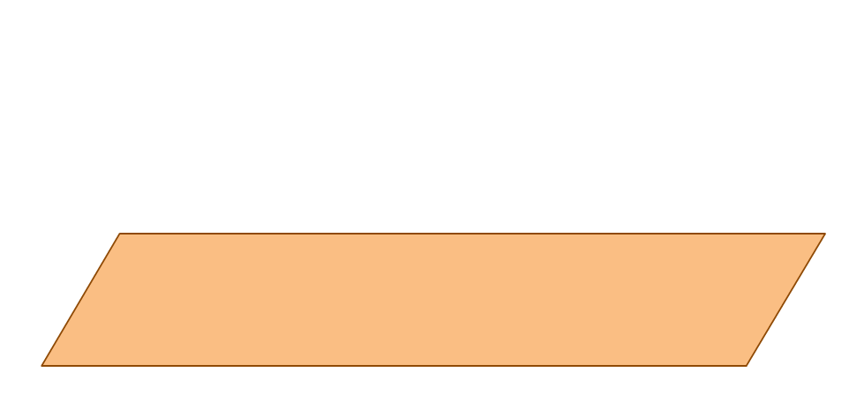
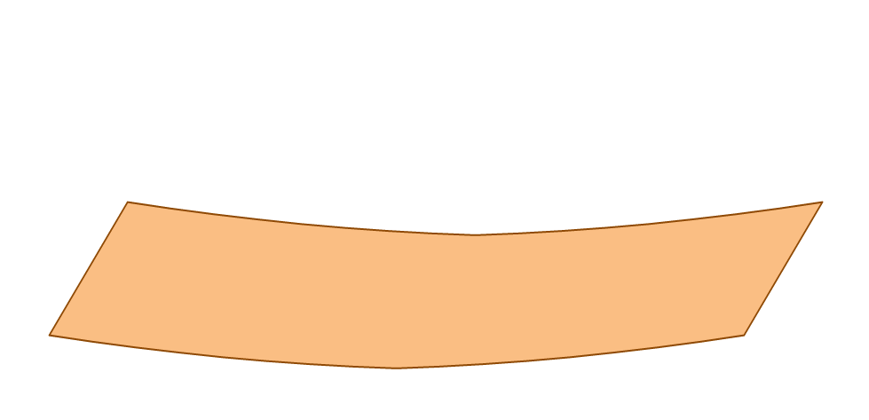
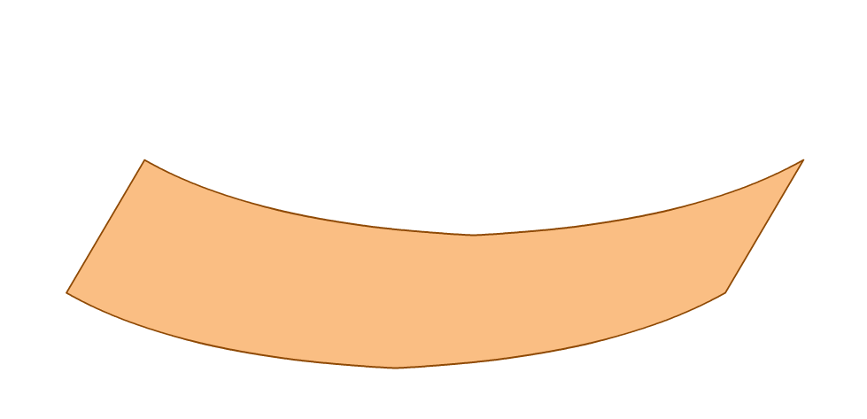
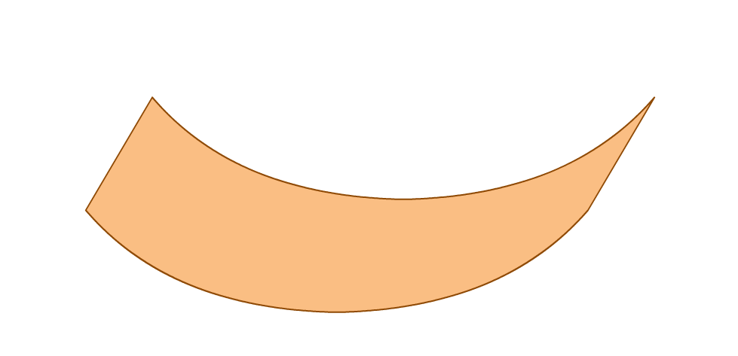
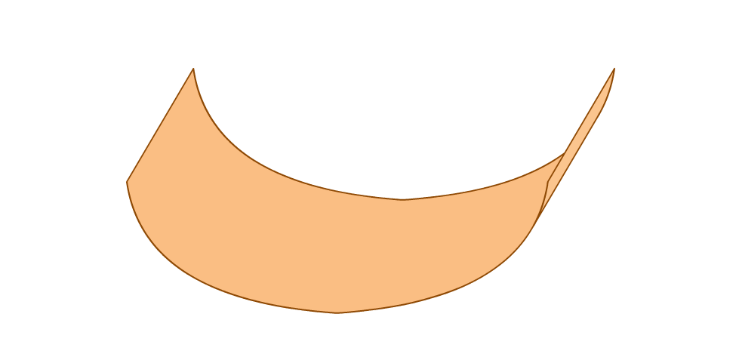
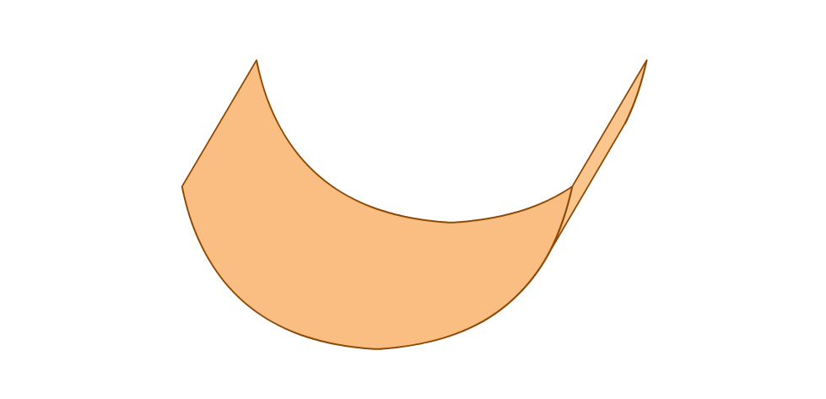
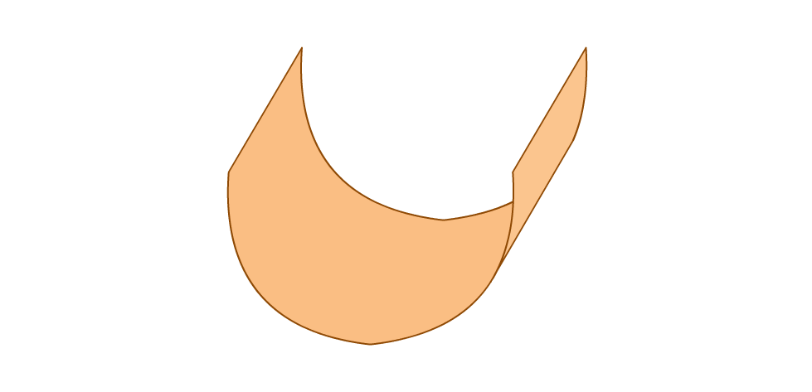
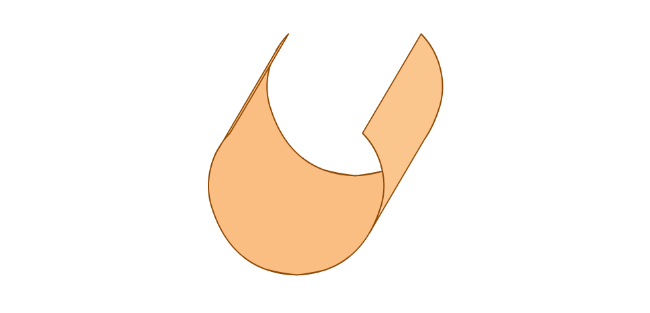
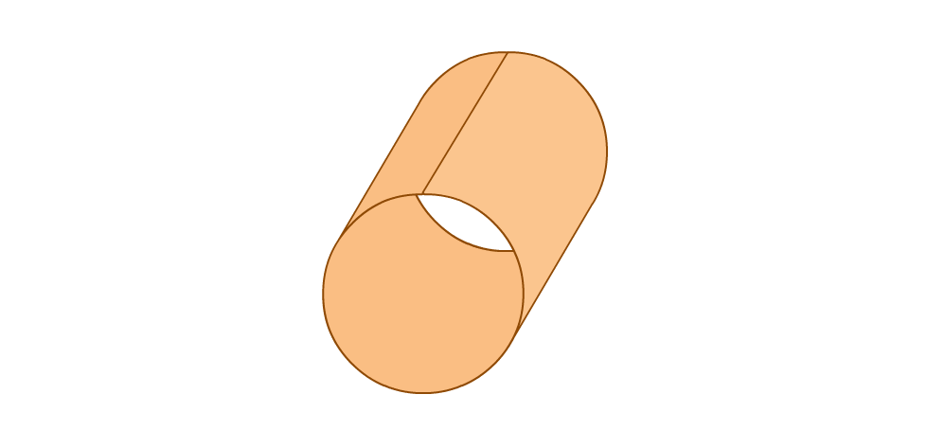


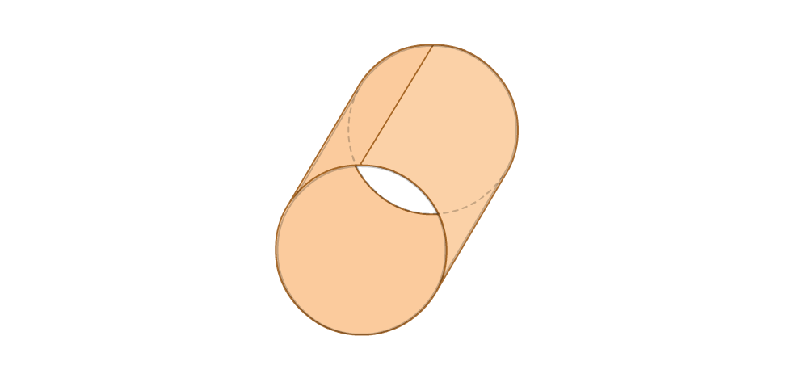

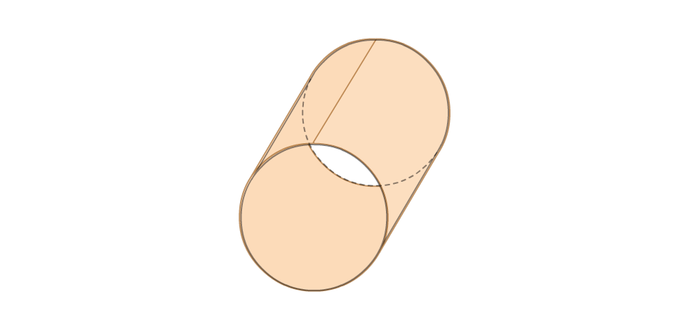
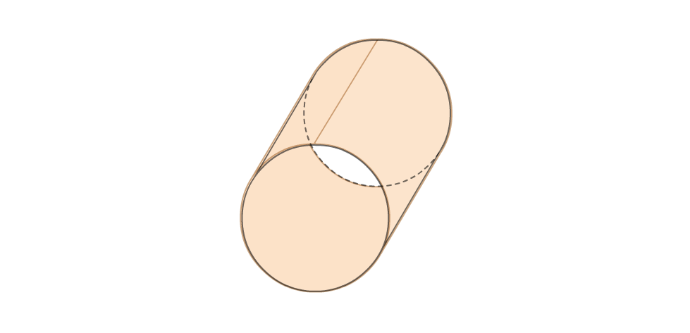
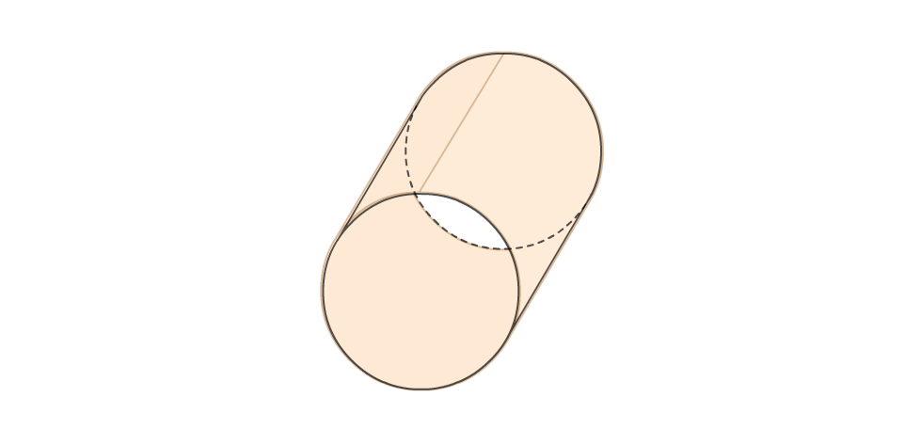
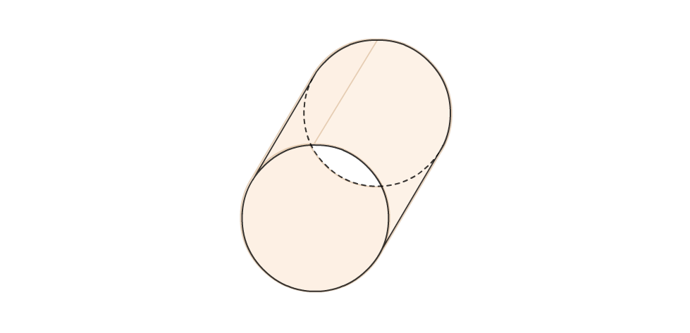
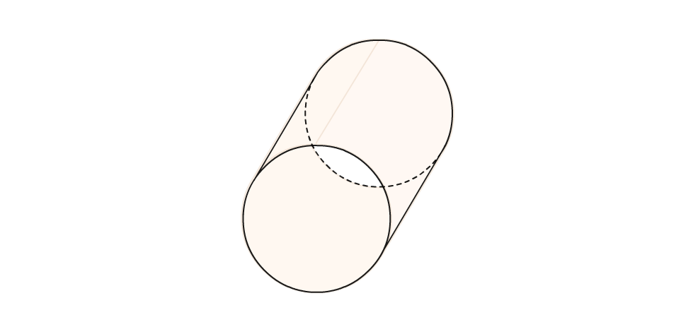
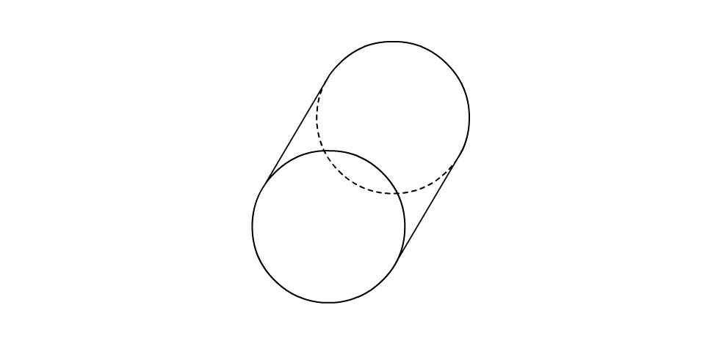
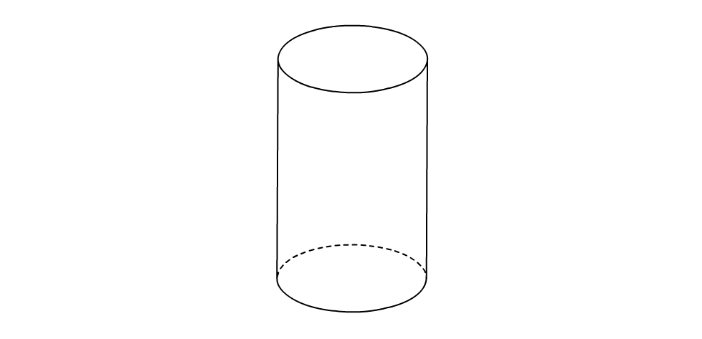
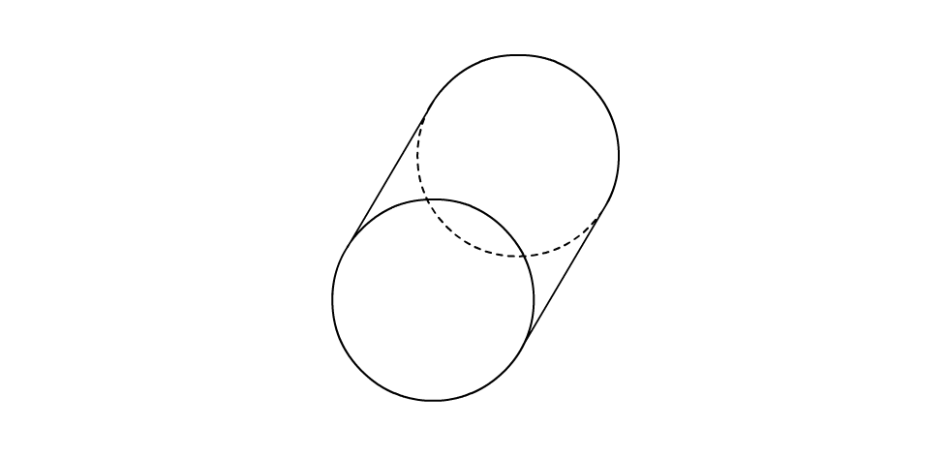
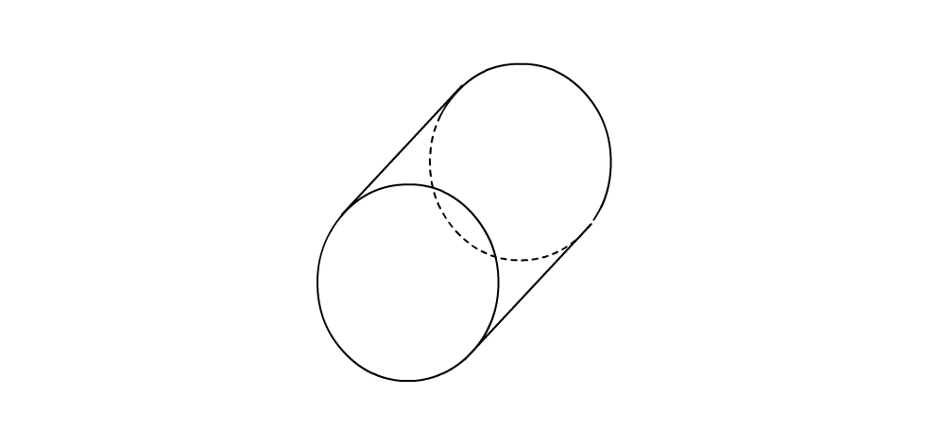
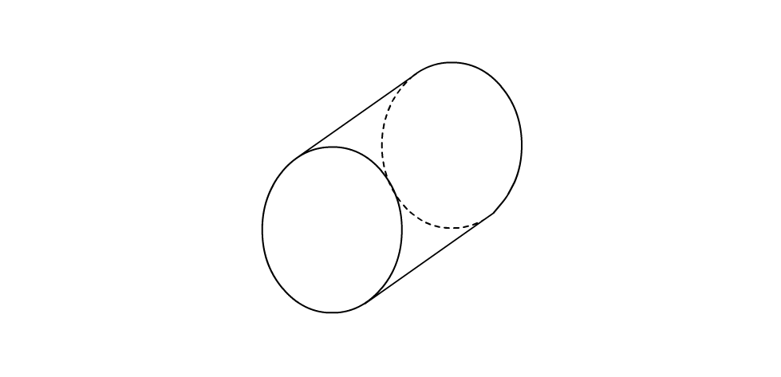
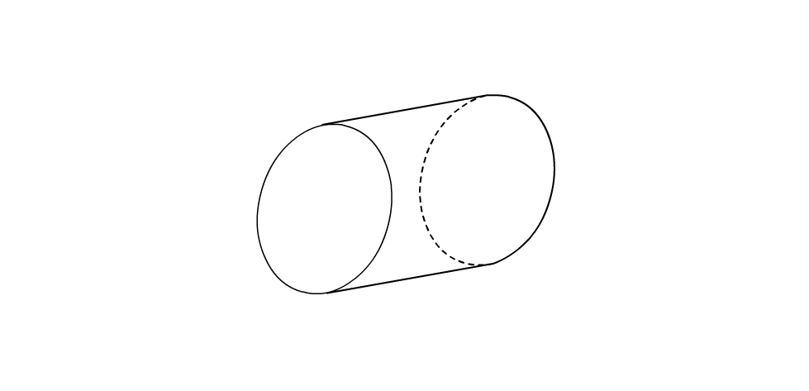
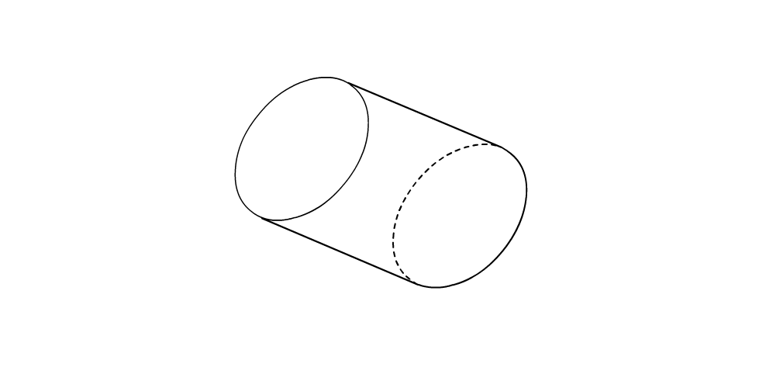
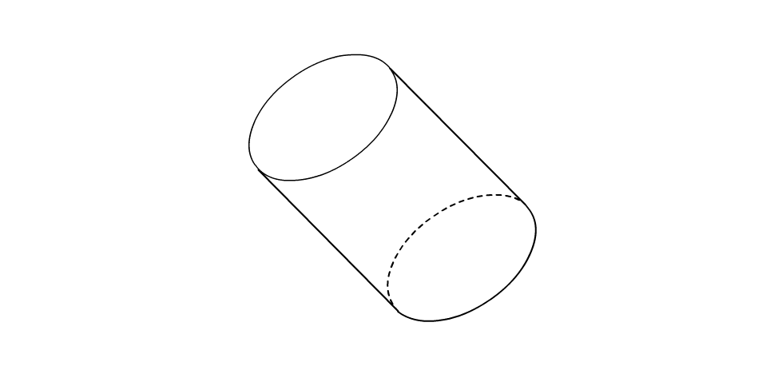
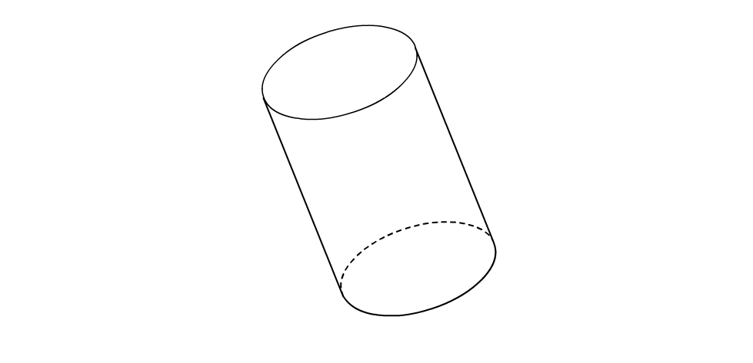

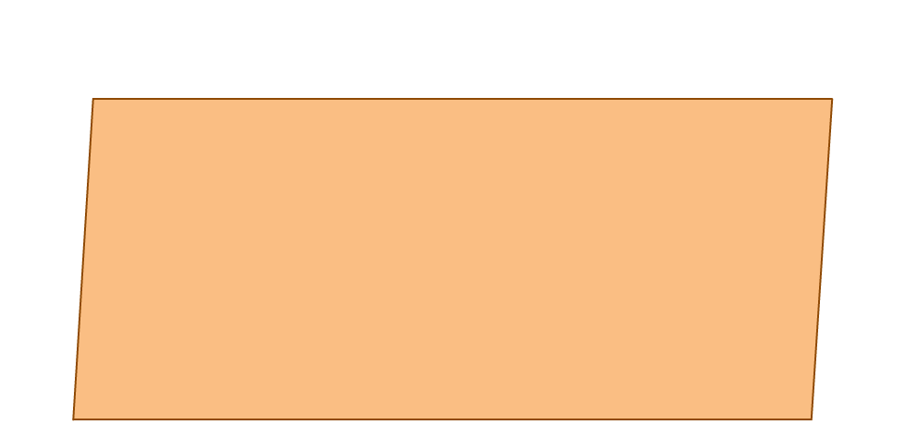
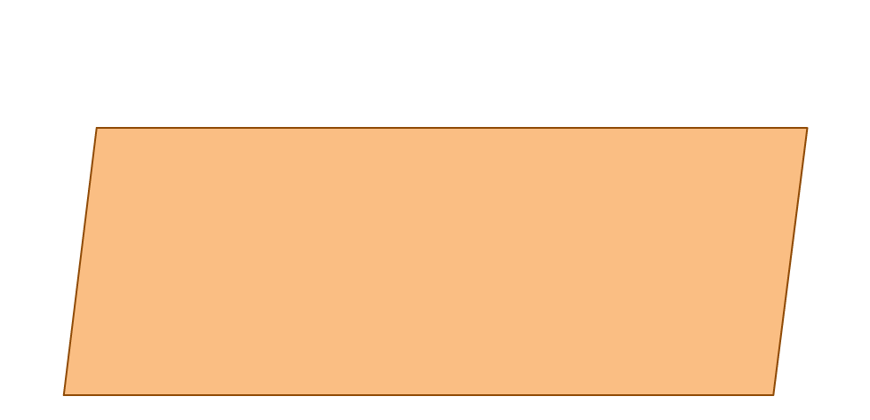
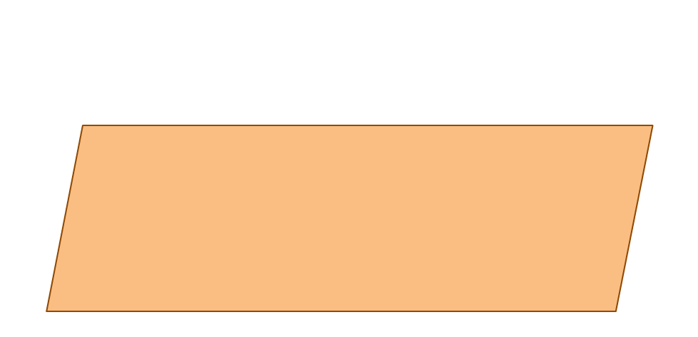
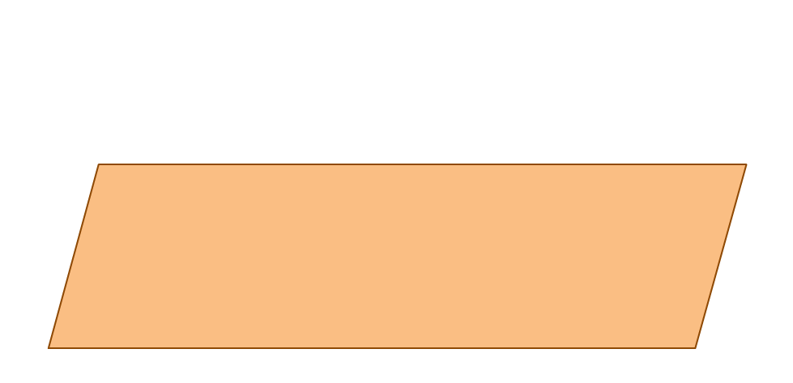
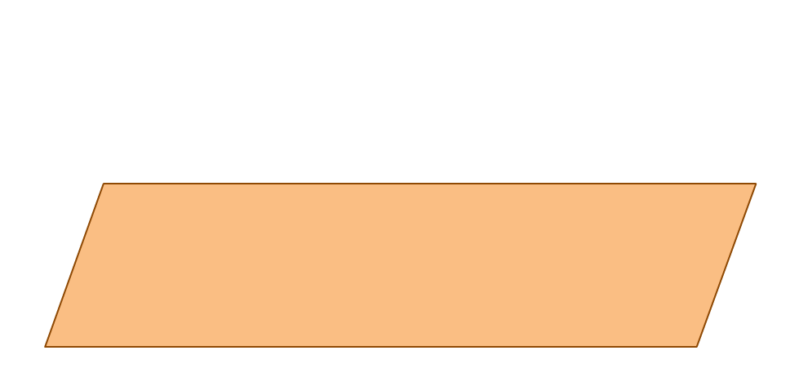
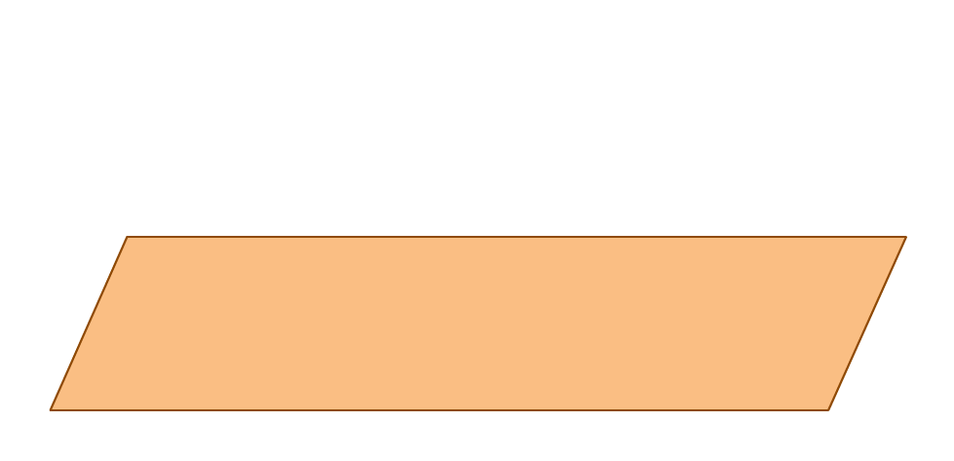
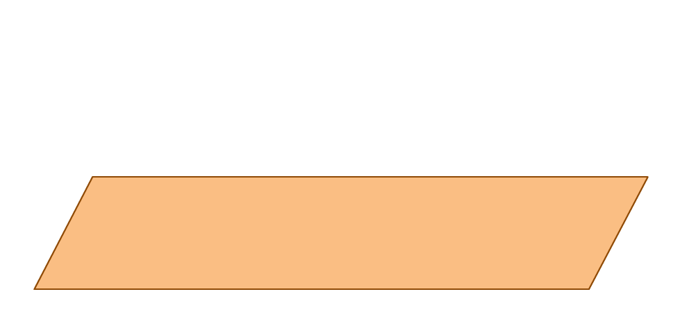
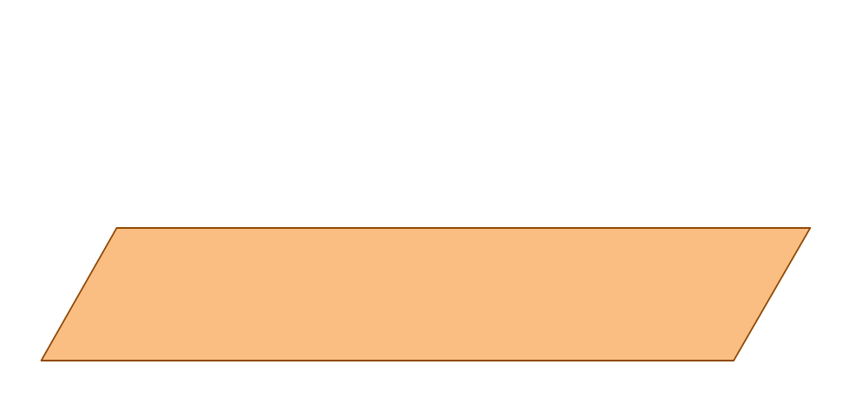
CURVED SURFACE AREA OF CYLINDER
Let us first understand
formula for curved
surface area of cylinder
CSA of cylinder =
2πrh
Let the radius of the
cylinder be ‘r’ and
height be ‘h’
Let us fold the
sheet to form an
open cylinder
Let us take a
rectangular-sheet of
length l and breadth b
b
When we fold the sheet lengthwise,
Now, we understand that,
length of sheet =
Circumference
Area of sheet =
CSA of cylinder
Area of this sheet = l × b
2πr
Breadth of sheet =
h
l
Area of the sheet =
CSA of cylinder
l
×
b
=
CSA of cylinder
2πr ×
h
=
CSA of cylinder

Slide 6
TOTAL SURFACE AREA OF CYLINDER
Total Surface Area =
2 π r (r + h)
The circular faces have
equal radii and are
parallel to each other
h
Area of circular face = πr²
r
TSA =
CSA of a cylinder
+
Area of 2 circular faces
=
2πrh
+
2
Area of a circular face
×
=
2πrh
2
πr²
+
=
2 π r
(h + r)

Slide 7
VOLUME OF CYLINDER
Volume
Volume of the cylinder is
the capacity of the cylinder
=
πr²h
h
The circular faces of the
cylinder have equal radii
and are parallel to each other
Area of circular face = πr²
r
Volume of cylinder =
Area of base
× Height
=
πr²
h
×

Slide 8
Module 8

Slide 9
SURFACE AREAS
AND VOLUMES
Sum based on Cylinder
Notes:
School
9

Slide 10
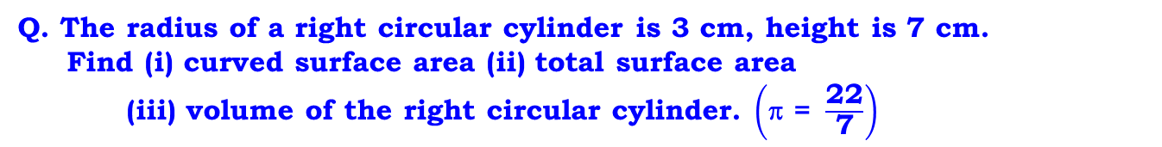
Q. The radius of a right circular cylinder is 3 cm, height is 7 cm.
Find (i) curved surface area (ii) total surface area
(iii) volume of the right circular cylinder. $\left(\text{ }\text{= }\frac{\text{22}}{\text{7}}\right)$
Sol.
Radius (r) = 3 cm
Height (h) = 7 cm
Curved surface area of cylinder = 2πrh
22
= 2 ×
× 3
× 7
What is formula for finding curved surface area of cylinder ?
7
2πrh
= 2 × 22 × 3
∴
Curved surface area of cylinder
= 132 cm²
Total surface area of cylinder = 2πr (r + h)
22
What is formula for finding total surface area of cylinder ?
= 2 ×
× 3
× (3 +
7)
2πr(r+h)
7
2 × 22 × 3 × 10
=
7
=
1320
7
∴
Total surface area of cylinder
= 188.57 cm²

Slide 11
Q. The radius of a right circular cylinder is 3 cm, height is 7 cm.
Find (i) curved surface area (ii) total surface area
(iii) volume of the right circular cylinder. $\left(\text{ }\text{= }\frac{\text{22}}{\text{7}}\right)$
Sol.
Radius (r) = 3 cm
Height (h) = 7 cm
What is formula for finding volume of cylinder
πr²h
Volume of cylinder = πr²h
22
=
× 3 × 3
× 7
7
= 22 × 9
∴
Volume of cylinder
= 198 cm³
∴
Curved surface area is 132 cm²,
Total surface area is 188.57 cm² and
Volume is 198 cm³

Slide 12
Module 9

Slide 13
SURFACE AREAS
AND VOLUMES
Sum based on Cylinder
Notes:
School
13

Slide 14
Q. The radius and height of a cylinder are in the ratio 3 : 7
and its volume is 1584 cm³. Find its radius.
Sol.
What is formula for finding volume of cylinder ?
r : h = 3 : 7
πr²h
Let the common multiple be ‘x’.
Radius (r) = 3x
∴ Radius (r) = 3x ,
height (h) = 7x
= 3
× 2
∴
r
= 6 cm
Volume of cylinder = 1584 cm³
∴
Radius of given cylinder is 6 cm
Volume of cylinder = πr²h
∴
1584 =
πr²h
∴
1584 =
22
× (3x)²
× 7x
7
∴
1584 =
22 ×
9 × x²
× x
8
176
1584
∴
= x³
22 × 9
∴
x³ = 8
∴
x = 2

Slide 15
Module 10

Slide 16
SURFACE AREAS
AND VOLUMES
Cone-Introduction
Sum based on Cone
Notes:
School
16

Slide 17
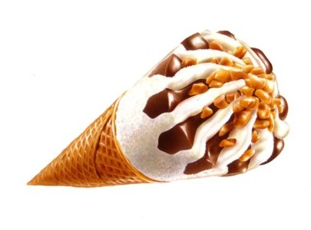
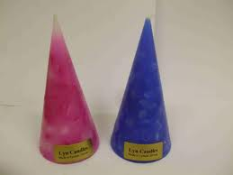
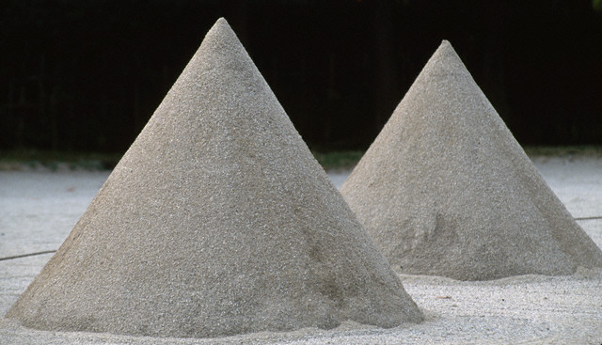
RIGHT CIRCULAR CONE
Examples :
Let us see some examples of Right Circular Cone
Conical candles
Ice Cream cone
Sand cone

Slide 18
RIGHT CIRCULAR CONE
A Right Circular Cone has two faces.
One circular face
Let us see geometrical figure of right circular cone
One curved face
A cone has radius (r),
height (h) and
slant height (l )
l
h
1
2
r
1

Slide 19
CURVED SURFACE AREA CONE
Observe a sector whose,
Now, we understand that,
Radius
=
R
r
CSA of cone
=
π rl
Area of sector
=
CSA of cone
length of arc
=
L
L
Radius of sector =
Slant height of cone
Now, length of arc =
Circumference
l
2πr
h
Area of sector = CSA of cone
Radius of the cone = r
Let us fold the sector
to form an open cone.
Height of the cone = h
L × R
R
=
CSA of cone
Slant height of the cone = l
2
2πr ×
l
=
CSA of cone
2

Slide 20
TOTAL SURFACE AREA OF CONE
Total surface area =
π r ( r + l )
h
l
Area of circular face = πr²
r
TSA =
CSA +
Area of circular face
=
πrl
+
πr²
=
πr
( l + r )

Slide 21
VOLUME OF CONE
1
Volume
=
×
πr²h
h
l
3
r

Slide 22
Q. The curved surface area of a cone is 4070 cm² and its diameter is 70 cm.
What is its slant height ?
Sol.
Curved surface area of a cone = 4070cm²
To find : l
Diameter (d) = 70 cm
∴ Radius (r) =
Curved surface area of cone = rl
35
What is formula for curved surface area of cone?
70
πrl
= 35 cm
2
22
∴ 4070 =
× 35
× l
37
7
814
4070 × 7
∴
= l
22 × 35
5
l = 37 cm
∴ Slant height of a cone is 37 cm.

Slide 23
Module 11

Slide 24
SURFACE AREAS
AND VOLUMES
SPHERE
Notes:
School
24

Slide 25

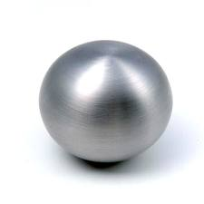
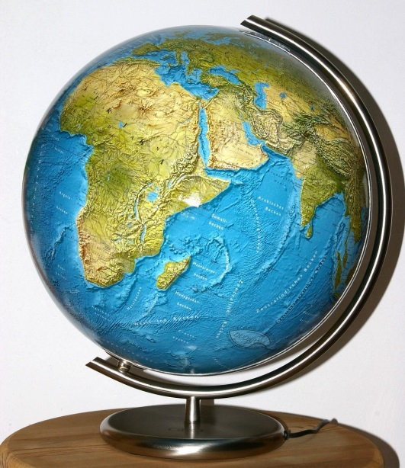
Sphere
Let us see few examples of sphere
Football
Metallic Ball
Globe

Slide 26
Sphere
Formulae :
1. Surface Area =
2. Volume =
r
4 π r²
4
π r³
3
Let us see an activity to understand the formula for total surface area of sphere

Slide 27

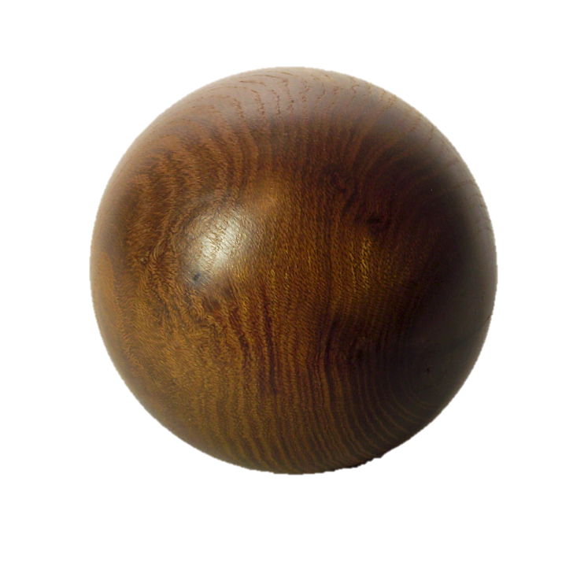
Surface area of sphere
Activity :
Total surface area of sphere
=
Length of string
=
4πr²
=
4
×
3.14
×
10²
=
1256
Mark the starting and
finishing points on the string, and slowly unwind the string from the surface of the ball.
When you have reached the ‘fullest’ part of the ball, use pins to keep the string in place, and continue to wind the string around the remaining part of the ball,
till you have completely covered the ball
let us take
a wooden ball and drive a nail into it
Taking support of the nail, let us wind a string
around the ball
Let radius = 10 cm

Slide 28
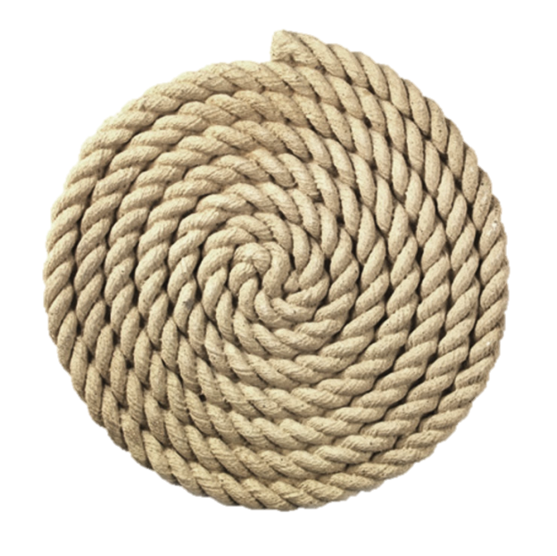

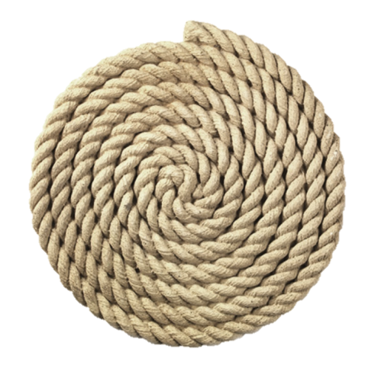

Total surface
area of sphere
=
1256 cm²
Length of
remaining string
Length of
remaining string
Length of string
used in winding
=
628
10 cm
=
942
=
πr²
=
3.14
× 10²
=
314
Length of
remaining string
Length of
remaining string
Length of
remaining string
=
1256
– 314
=
942
– 314
=
628
– 314
=
942
=
628
=
314
Then on a sheet of paper, draw four circles with radius equal to the radius of the ball i.e. 10 cm
Start filling the circles one by one, with the string you had wound around the ball
Start filling the next circle with the string
Start filling the next circle with the remaining string
Start filling the next circle with the string

Slide 29
Module 12

Slide 30
SURFACE AREAS
AND VOLUMES
Sums based on Sphere
Notes:
School
30

Slide 31
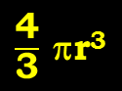
Q. Find the volume and surface area of sphere of radius 4.2 cm.
( = 22/7)
Sol.
Radius of sphere = 4.2cm
4
$\frac{\text{4}}{\text{3}}$ πr³
Volume of sphere
= r³
What is formula for finding volume of sphere ?
3
4
22
=
×
× 4.2
× 4.2
× 4.2
3
7
2
14
4
22
42
42
42
=
×
×
×
×
3
7
10
10
10
4 × 22 × 2 × 42 × 42
=
10 × 10 × 10
310464
=
1000
= 310.464 cm³
∴ Volume of sphere
is 310.464 cm³

Slide 32
Q. Find the volume and surface area of sphere of radius 4.2 cm.
( = 22/7)
Sol.
Radius of sphere = 4.2cm
What is formula for finding surface area of sphere ?
Surface area of sphere = 4r²
4πr²
22
= 4
×
× 4.2
× 4.2
7
6
22
42
42
= 4
×
×
×
7
10
10
4 × 22 × 6 × 42
=
10 × 10
22176
=
100
= 221.76 cm²
∴ Surface area of sphere
is 221.76 cm²

Slide 33
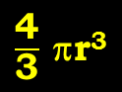
Q. The surface area of sphere is 616 cm². What is its volume ?
( = 22/7)
Sol.
Hint :To find r.
Surface area of sphere = 616cm²
Surface area of sphere = 4r²
∴
616
= 4r²
∴
616
22
= 4
×
× r²
154
7
7
616
× 7
∴
= r²
4 × 22
∴
r² = 49
?
What is formula for finding volume of sphere ?
$\frac{\text{4}}{\text{3}}$ πr³
What is formula for finding surface area of sphere ?
4πr²
∴
r = 7 cm

Slide 34
Q. The surface area of sphere is 616 cm². What is its volume ?
( = 22/7)
Sol.
r = 7 cm
4
=
r³
Volume of sphere
3
4
22
=
×
× 7
× 7
× 7
3
7
4 × 22 × 7 × 7
=
3
4312
=
3
= 1437.33 cm³
∴ Volume of the sphere is 1437.33 cm³

Slide 35
Thank You

